Slide 1
Aug 4 keyword parameters

Slide 2
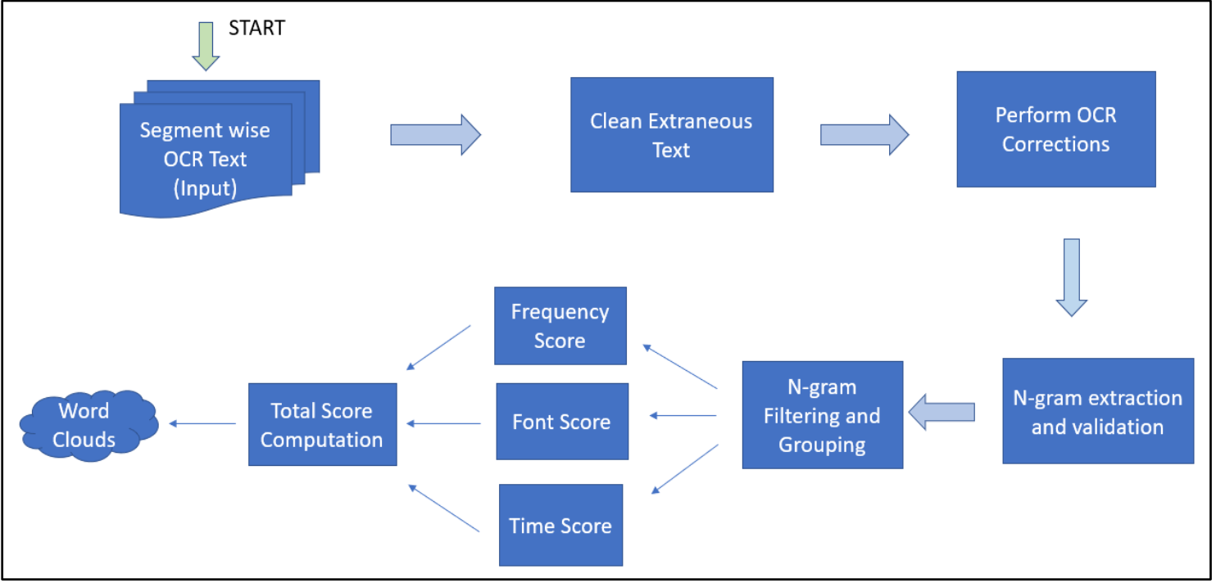
Flowchart of Keyword parameter

Slide 3
Discard Extraneous Text
discards text occurring repeatedly across the lecture at similar positions
university name, or the instructor's name, or the course name on each slide of the lecture and these words appear almost at the same positions on all the slides which do not represent content.
OCR gives Left, Right, Top, Bottom positions
algorithm to eliminate the words based on positions.
elimination criteria is if they appear 40% of the total transition points
similar positions’ instead of ‘same positions
cosine similarity

Slide 4
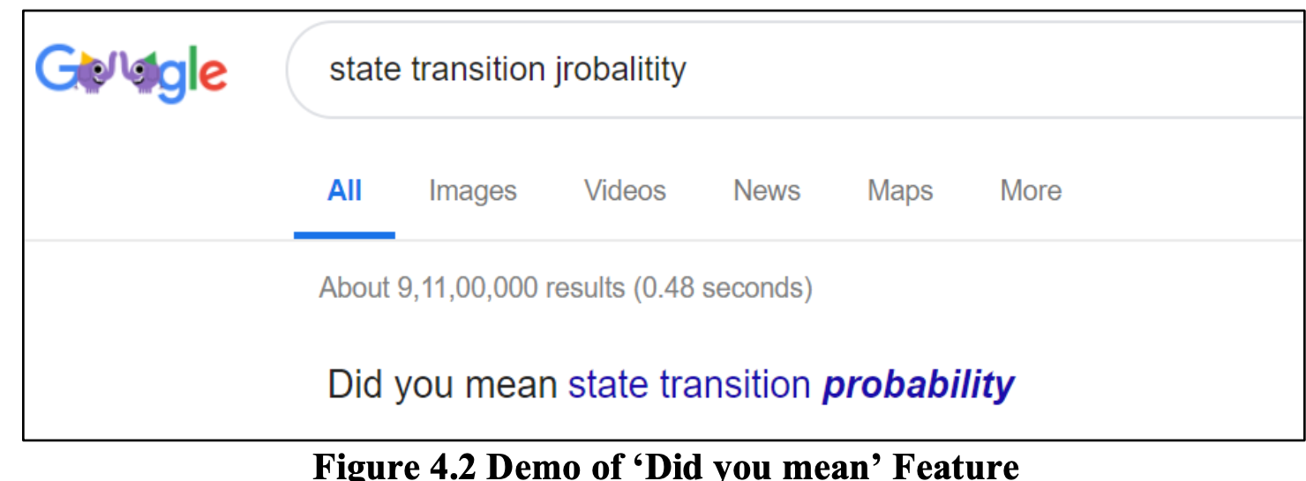
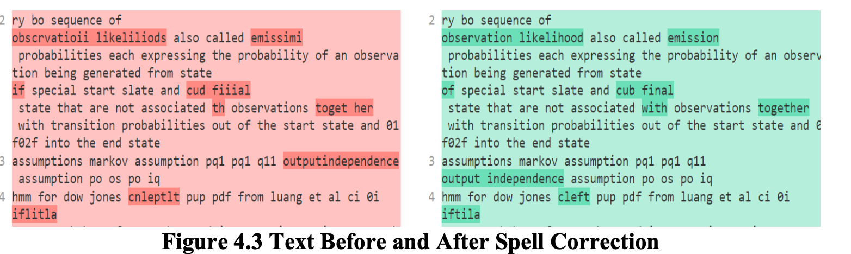
OCR Error Correction
Google Search API -Did you mean feature

Slide 5
Refine OCR Corrections
A word must appear 3 times in the OCR text to be considered as a valid word and consists of letters only
Valid word list vs invalid word list
Edit distance criteria is used to replace invalid word by valid word

Slide 6
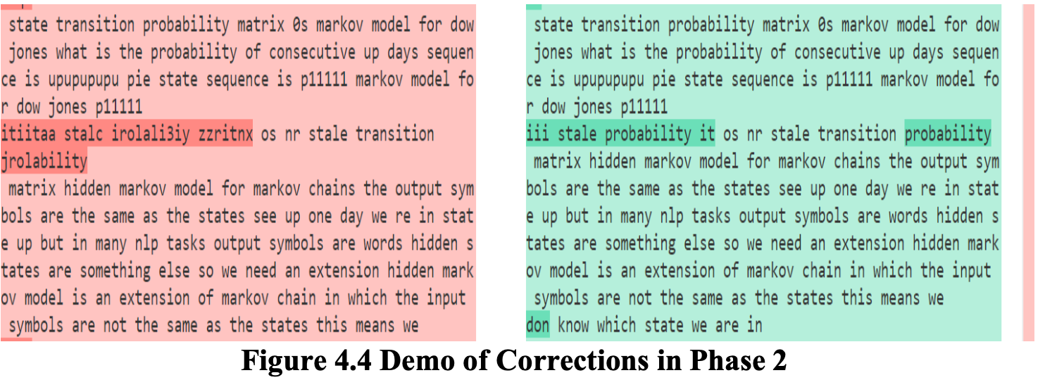
Refine OCR Corrections

Slide 7
N-gram Extraction,Validation,Filtering,Grouping
N-gram Extraction and Validation
API called ‘PhraseFinder’
the results given by this API, the keyword detection algorithm validated the n-grams by discarding the ones with count 0.
N-gram Filtering and Grouping
Stop word Removal
stemming

Slide 8
Frequency Score
The frequency score of an n-gram internally depends on a few measures as stated below:
Term Frequency
Inverse Segment Frequency
Domain Importance: This measure identifies n-grams containing domain related words and assigns higher importance.
Reduce Weights of Rare Words: This measure identifies n-grams containing rare words and reduces their weight.

Slide 9
Frequency Score….
Term Frequency: This measure determines the count of an n-gram in a segment.

Slide 10
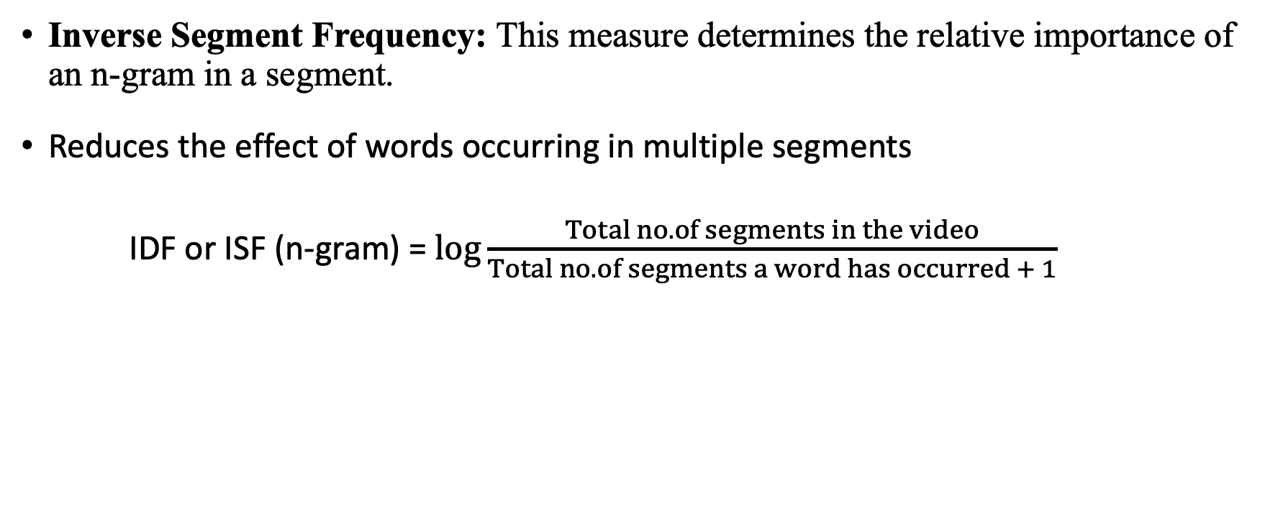
Frequency Score….
Inverse Segment Frequency: This measure determines the relative importance of an n-gram in a segment.
Reduces the effect of words occurring in multiple segments
IDF or ISF (n-gram) = $\log{\frac{Total no. of segments in the video}{Total no. of segments a word has occurred + 1}}$

Slide 11
Frequency Score….
Domain importance and reduce weight of rare words:
( In current algorithm domain weight=2 and mistake weight=0.5, English weight =1)
def boostWeightsofNgrams():
n-gram is splitted in terms
wt = 1 for terms in n-gram: if term in domainList (oxford domain dictionary) wt *= domain_weight elif addWtReduction: if englishDict: wt *= English weight else: wt *= mistake_weight

Slide 12
Frequency Score….
Frequency score = Term Frequency * Inverse Segment Frequency *boostWeightsofNgrams

Slide 13
Font score
All the font sizes of the words are squared to distinguish the difference clearly
Average font weights of the word across each segment of the video are calculated as the word can appear multiple times
Then it calculates the weights of n grams by splitting the n-gram into ‘n’ terms and taking the ratio of the sum of the average weights of the terms to the total number of terms.

Slide 14
Time score
The total no. of seconds for which the word appears in a segment is calculated

Slide 15
Final Score
Finally,
Final Score of N-gram = (frequency weight * Final Frequency Score) + (font weight * Final Font Score) + (time weight * Final Time Score)

